Slide 1
Cordova High School: Leading the Pack

Slide 2
Join us as Superintendent Dr. Marie N. Feagins shares MSCS's remarkable journey. Discover how momentum is turning into action that’s shaping brighter futures for every student. Be a part of the movement, the mission, and the future. Let’s keep pushing forward together! Date: January 29, 2025 Time: 1:00 PM

Slide 3
STATE OF THE SCHOOLS Agenda
Cordova High Distinctives
Report Card Grade
Achievement
TVASS Scores
College and Career Readiness
School Climate (attendance and behavior)
Ways Parents can stay informed and support your child’s school

Slide 4
Cordova High Distinctives
Largest School in MSCS
Diversity
Student Support Services
Counseling Service
Behavioral Support
Language Support
Social and Emotional Learning Support
Three distinct health science programs
Sport and Human Performance
Nursing
Emergency Services
Veterinary and Animal Science
Engineering
BioSTEM
Residential and Commercial Construction
Maintenance and Light Repair
Coding
Supply Chain
Business/Office Management
Fine Arts

Slide 5
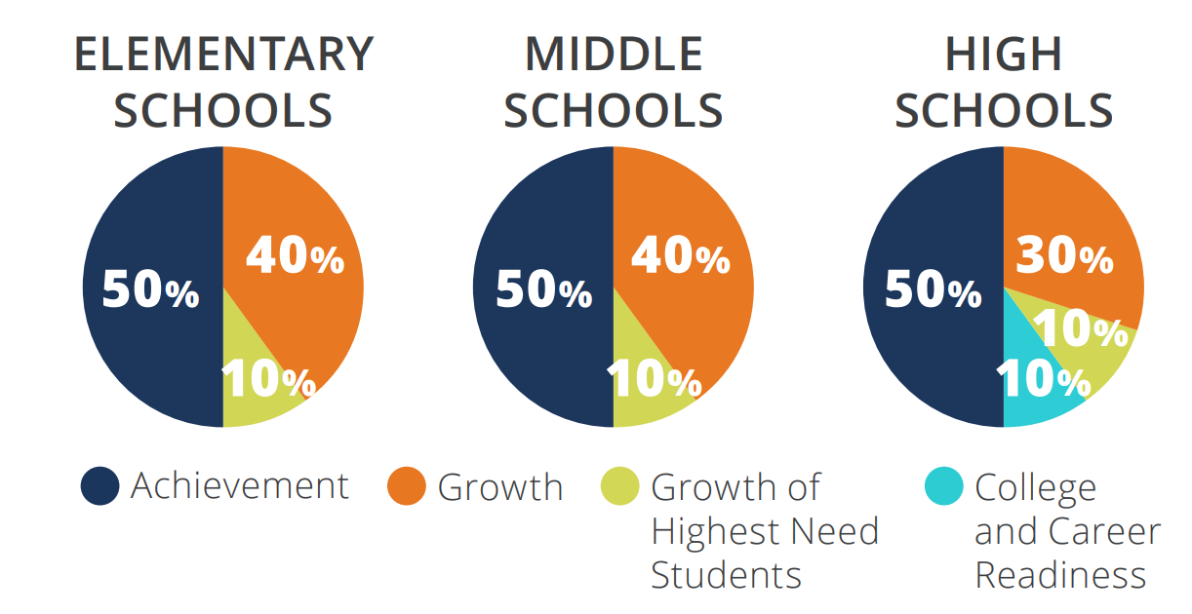
Report Card Grade

Slide 6
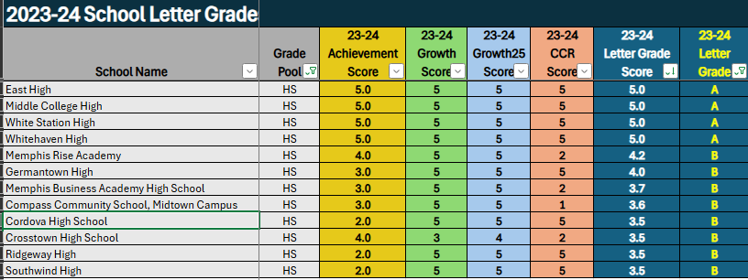
We went from a C to a B!!!!
Cordova High is an Ignite school for the 2024-2025 SY.
Cordova High will be a Soar school for the 2025-2026 SY.

Slide 7
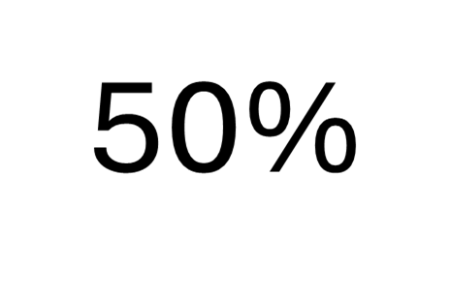
Achievement
Achievement Scores come from:
Math (Algebra 1, Algebra 2, Geometry
English (English 9, English 10)
Biology
US History

Slide 8
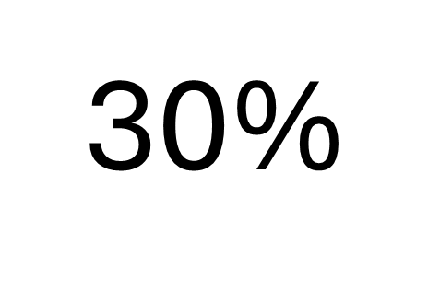
TVAAS Scores
Growth measures how well as student is EXPECTED to do on the EOC exam.
The expected score is calculated from a student’s entire historical TCAP test scores
Cordova High as been a Level 5 school for composite TVAAS Growth for several years in a row.

Slide 9
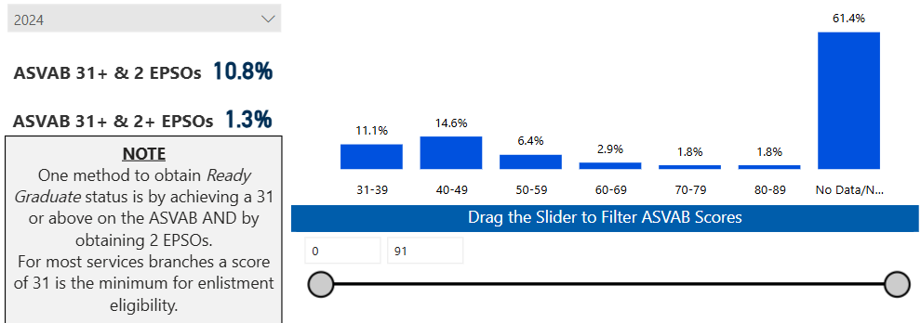
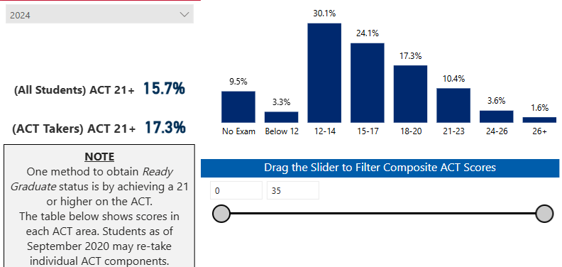
College and Career Readiness
ACT Composite: 16.7

Slide 10
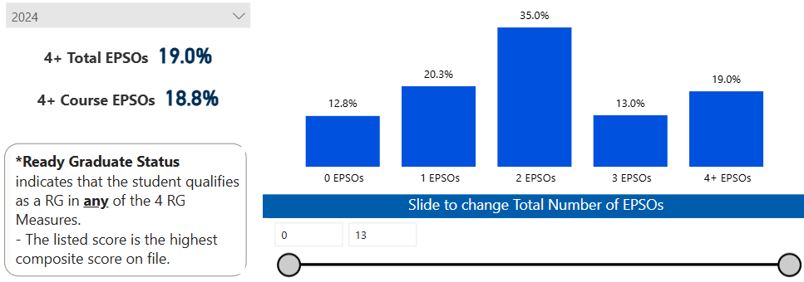
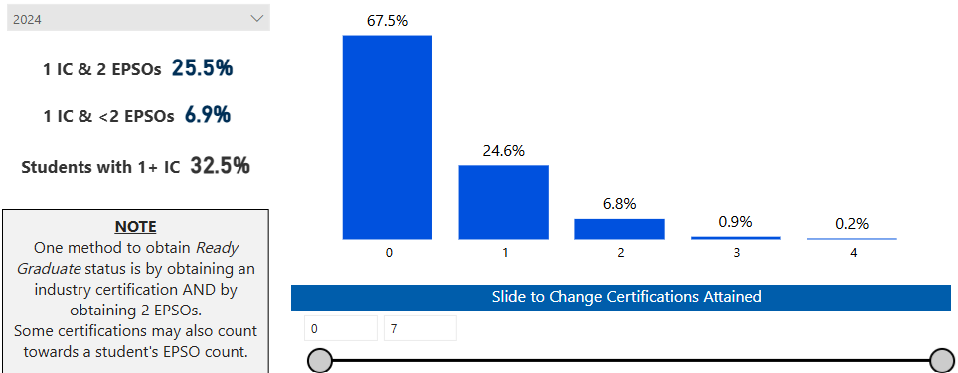

Slide 11
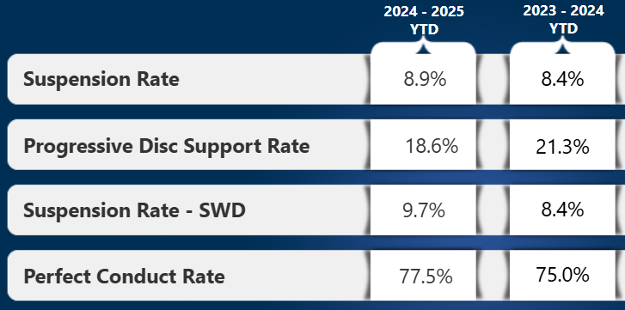
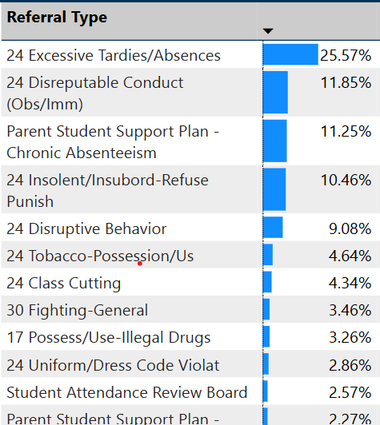
School Climate

Slide 12
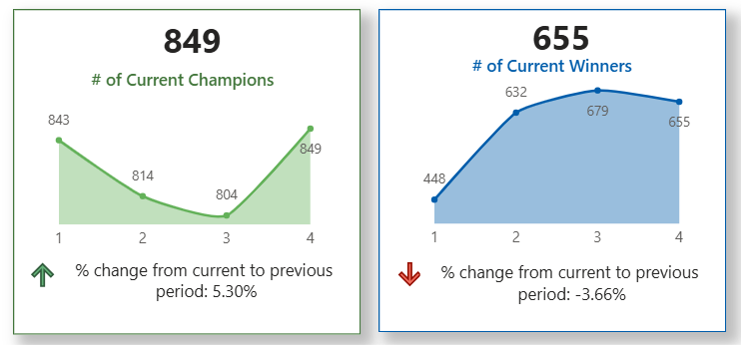
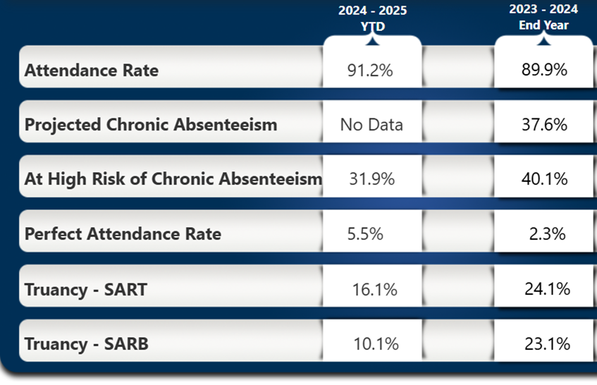
C.O.M.E. TO WIN
Count on Me Everyday

Slide 13
Ways stay informed and support your school
Follow us on Instagram @cordovahighwolves
Make sure your information is correct in PowerSchool
Do not block emails, calls, or texts
Download the PowerSchool parent app. Set your custom notifications for grades and attendance
Attend events like Open House, Parent Conference Night, College Fairs, Senior Parents Night, Junior Parents Night
Promote a positive narrative in the community and on social media
Challenge misinformation, “Fake News”, and overblown issues

Slide 14
Upcoming Parent Events
Date | Event | Audience
Feb 13 | Parent Conference Night | All Parents
Feb 20, March 24 | Calculator Night | All Parents
May 1 | Title I Night | All Parents
May 1 | Junior Parent Night | 11th grade Parents

